Slide 1
Welcome to the Uber-Data-Analyst Project
Project-by chetan

Slide 2
Uber Ride Booking Dataset
Overview
This dataset contains ride booking details from Uber, providing insights into user behavior, ride preferences, and booking patterns. It helps analyze trends such as ride categories, booking times, distances, and weekly usage.
Key Features of the Dataset
Ride Category – Identifies whether the ride was booked for business or personal purposes.
Booking Purpose – Specifies the reason for booking, such as meetings, errands, entertainment, etc.
Time of Booking – Indicates when users book rides (morning, afternoon, evening, night).
Weekly Trends – Shows ride bookings across different days of the week.
Ride Distance – Analyzes the distance covered per ride, highlighting short vs. long trips.

Slide 3
Objective
In which category do people book the most Uber rides?
2. For which purpose do people book Uber rides the most?
3. At what time do people book cabs the most from Uber?
4. In which months do people book Uber rides less frequently?
5. On which days of the week do people book Uber rides the most?
6. How many miles do people usually book a cab for through Uber?

Slide 4
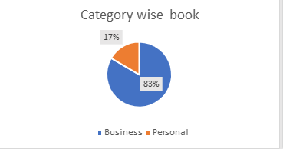
Q1. In which category do people book the most Uber rides?
Conclusion
The pie chart titled "Category wise book" shows the percentage of Uber rides booked for business and personal purposes. The data reveals that 83% of Uber rides are booked for business purposes, while only 17% are booked for personal use. This indicates that Uber is primarily used for business-related travel, suggesting a strong demand for corporate transportation services.

Slide 5
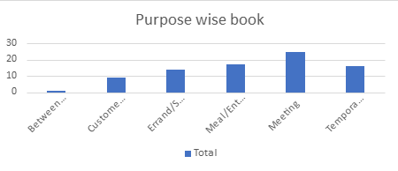
Q2. For which purpose do people book Uber rides the most?
Conclusion
The bar chart titled "Purpose wise book" illustrates the distribution of Uber rides based on different purposes. The data suggests that the highest number of Uber rides are booked for meetings, indicating that business or work-related travel is a significant reason for using Uber. Other notable purposes include meal/entertainment, errands/shopping, and temporary use, which also have a considerable number of bookings. Between-location travel has the lowest number of bookings. This analysis highlights that professional and social activities are key drivers for Uber ride bookings.

Slide 6
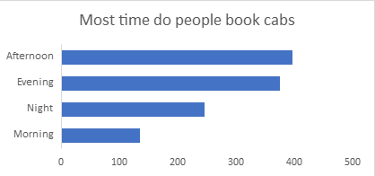
Q3. At what time do people book cabs the most from Uber?
Conclusion
The bar chart titled "Most time do people book cabs" shows the distribution of Uber ride bookings across different times of the day. The data indicates that afternoon has the highest number of cab bookings, followed by evening. This suggests that people commonly use Uber during these periods, likely for work commutes, business meetings, or social activities. Night and morning have comparatively fewer bookings, indicating that people rely less on Uber during these hours. This trend highlights that peak demand for Uber rides occurs in the afternoon and evening.

Slide 7
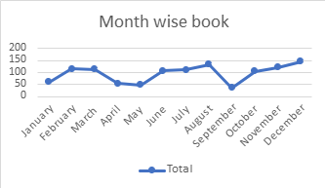
Q.4 In which months do people book Uber rides less frequently?
Conclusion
The bar chart titled "Most time do people book cabs" shows the distribution of Uber ride bookings across different times of the day. The data indicates that afternoon has the highest number of cab bookings, followed by evening. This suggests that people commonly use Uber during these periods, likely for work commutes, business meetings, or social activities. Night and morning have comparatively fewer bookings, indicating that people rely less on Uber during these hours. This trend highlights that peak demand for Uber rides occurs in the afternoon and evening.

Slide 8
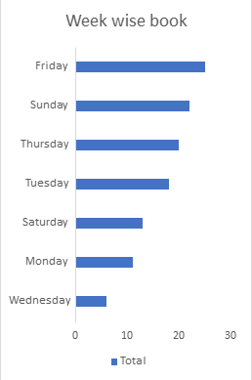
Q5. On which days of the week do people book Uber rides the most?
Conclusion
The bar chart titled "Week wise book" illustrates Uber ride bookings across different days of the week. The data reveals that Friday has the highest number of bookings, followed by Sunday and Thursday, suggesting increased demand toward the end of the workweek and on weekends. Tuesday, Saturday, and Monday have moderate bookings, while Wednesday has the lowest number of bookings. This trend indicates that people use Uber more frequently for weekend outings, work-related travel near the end of the week, or social activities, while mid-week sees comparatively lower demand.

Slide 9
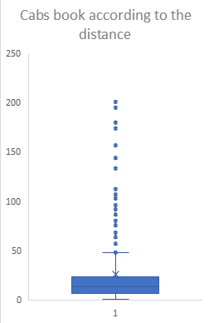
Q6. How many miles do people usually book a cab for through Uber?
Conclusion
The box plot titled "Cabs book according to the distance" shows the distribution of Uber ride distances. The data suggests that most Uber rides are booked for shorter distances, as indicated by the concentration of values within the interquartile range (IQR). However, there are several outliers representing long-distance trips, suggesting that a few users book cabs for significantly greater distances. The whiskers extend moderately, indicating some variation in trip lengths, but the majority of rides remain within a common shorter range. This trend highlights that Uber is primarily used for short to mid-range travel, with occasional long-distance bookings.

Slide 10
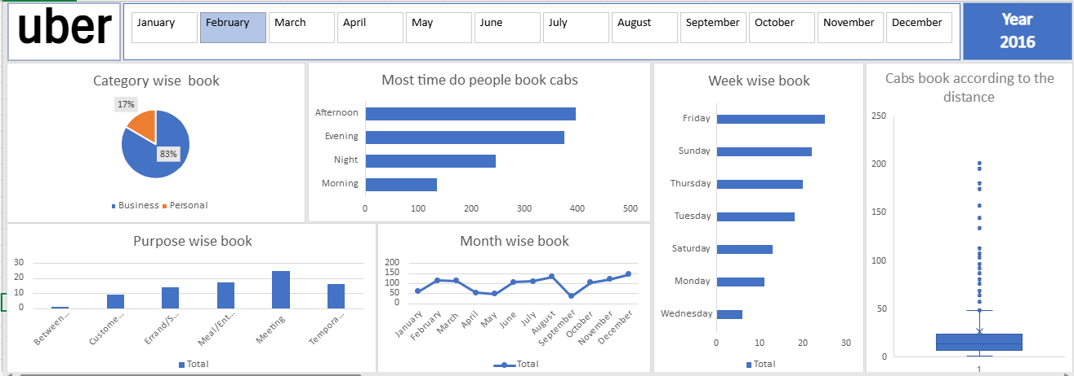
Dashboard

Slide 11
THANK YOU

